Slide 1
Densest Subgraph Discovery on the GPU
Hunter Gareau Thesis Defense

Slide 2
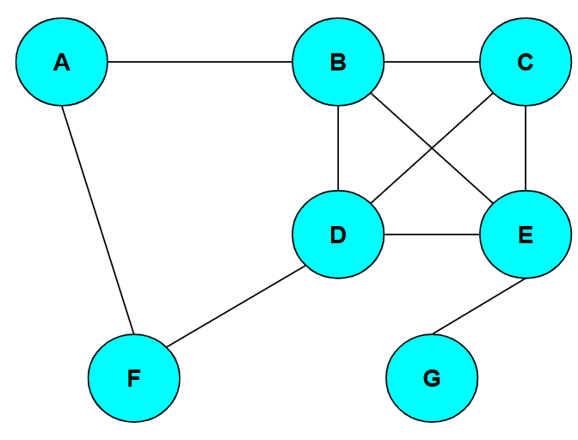
Graphs and Graph Mining
Graphs are a way of representing connections and relationships in data subjects.
They are composed of vertices and edges. Edges can be directed but we will be using undirected graphs.
They can represent data from social networks to neural networks to power grids.
The analyzation of graphs to find patterns and information is called Graph Mining.

Slide 3
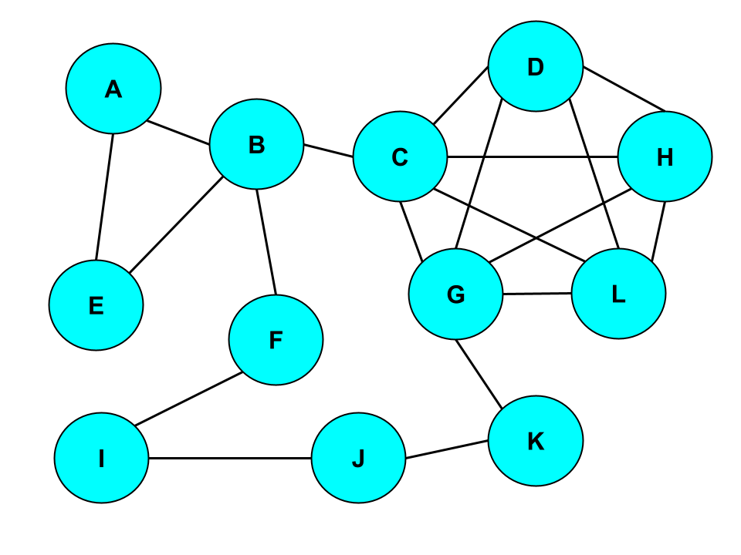
Graph Example
As an example, say this graph is a representation of different Facebook groups, with the vertices being these groups and the edges representing that the two groups share an administrator.

Slide 4
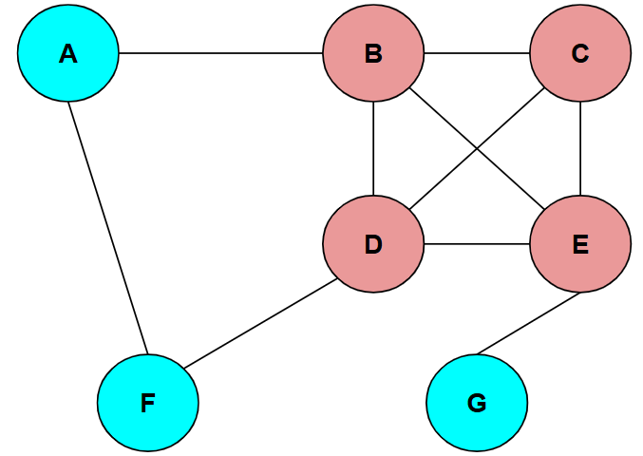
Densest Subgraph Discovery Problem
One fundamental Graph Mining problem is the Densest Subgraph Discovery Problem (DSD).
Edge density is the ratio of edges to vertices in a given graph.
The DSD aims to find the subgraph of highest density in a given graph.
Knowing the densest subgraph has various uses depending on what the graph represents.

Slide 5
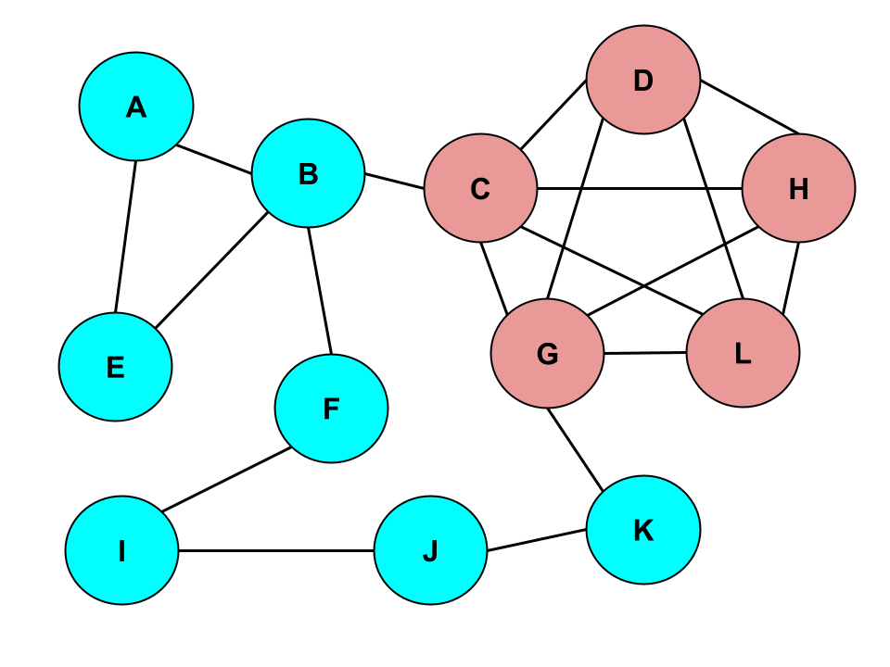
Densest Subgraph Application
Returning to our Facebook group graph, an example use of the DSD is that by finding the densest subgraph in this example, we’ve identified a potential echo chamber.

Slide 6
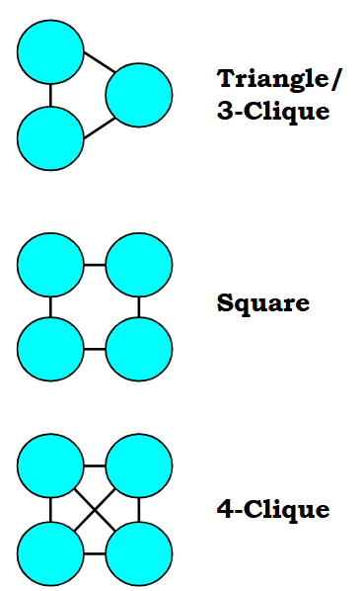
Cliques, Motifs, and Clique Density
Motifs are small subgraphs of a specific edge layout (such as triangles, squares, 4-paths, etc.), which are useful for examining more patterns and types of connections.
Cliques are a specific type of motif, where every vertex in the miniature subgraph is connected to one another.
Motif/Clique density is the ratio of motif or clique instances to the number of vertices in a subgraph.

Slide 7
Parallel Programming
Many solutions to the DSD exist, however they are serialized algorithms which get taxing quickly for Graph Mining programs when handling vertices and edges one at a time in large graphs/data sets.
By running in parallel, many vertices or edges can all be handled at once and cut down on runtime.
Serialized programs run entirely on the CPU (Central Processing Unit), but parallel programs often utilize the GPU (Graphics Processing Unit).

Slide 8
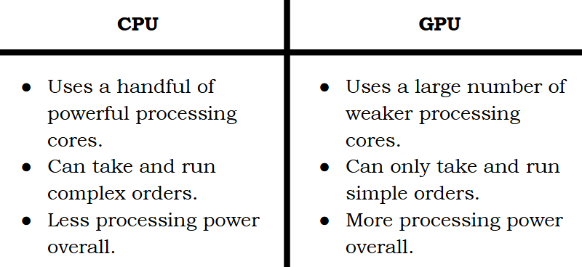

Slide 9
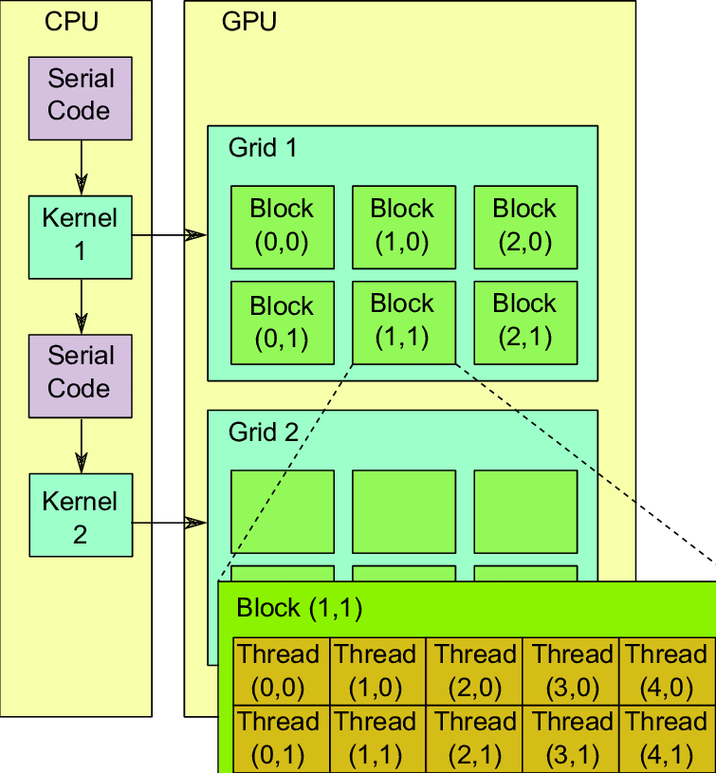
GPU Structure
It is important to understand the basic structure of the GPU to use it effectively.
Processes and commands are run on Threads (a unit of execution).
Threads are a hierarchal structure, and data is more costly to share between levels.
32 threads make up a Warp. The instructions are the same between threads in a warp.
Some number of warps make up a Block (the number depends on the GPU).
Final level is Grids, made up by blocks. When a kernel (parallel process) is launched, it is mapped to the processors of a grid.

Slide 10
CUDA by NVIDIA
Writing a program entirely in the simple language available to the GPU would be extremely difficult.
CUDA (Compute Unified Device Architecture) is a tool created by NVIDIA that allows programs written in the serial language C++ to execute kernels on the GPU and access the results of these kernels.
This effectively allows for more complex programs to switch between the CPU and GPU as needed.

Slide 11
Our Goal
The goal of this research project was to adapt an algorithm that solves the DSD to a parallel CUDA program.
This serves two purposes: creating a more efficient solution to the DSD and serving as further research into the efficacy and computational power of parallel programming.

Slide 12
Existing Solutions
The first necessary step was deciding on an algorithm to adapt. Many exist due to the prevalence of the DSD.
A highly important one is Goldberg’s Maximum Flow algorithm which will be covered later. This is an exact solution to the DSD, but there are quicker algorithms that approximate the solution.

Slide 13
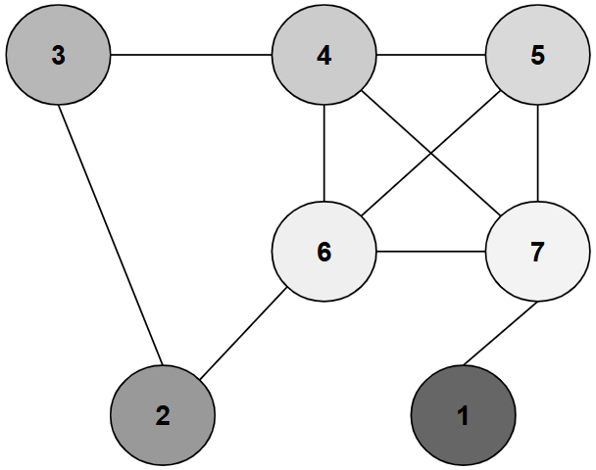
Greedy Peeling and Greedy Peeling++
A famous approximation algorithm by Moses Charikar is the Greedy Peeling algorithm, which finds the vertex with the least number of connections (referred to as degree), and removes it. By checking the density of the graph after each peel, you can keep track of which subgraph was densest.
Greedy++ is an algorithm that builds on this. By running the Greedy algorithm multiple times and assigning priority to each vertex based on when it is removed, an even denser subgraph can be found given enough iterations.

Slide 14
Related Works
Before we continue, I’d like to highlight some similar problems to the DSD and existing solutions to them.
One variation of the DSD is the Densest k-Subgraph problem, where the goal is to find the densest subgraph of size k. One such solution to this approximates this by taking the subgraph of only the top k/2 vertices with the highest degree.
Another variation of the DSD is for directed graphs, where the density definition is changed to reflect direction from one subgraph to another. An exact solution to this was created by Charikar which finds the optimal solution to a linear programming problem based on the ratio of the sizes of the subgraphs.
The final variation I’ll mention is the Optimal Quasi-Clique Problem, which uses the edge surplus definition instead of density to favor subgraphs with a shorter diameter. One solution to this is a variation of the greedy peeling algorithm.

Slide 15
CoreExact
After deliberating over many of the existing DSD solutions, the one we settled on parallelizing was the CoreExact algorithm from the paper “Efficient Algorithms For Densest Subgraph Discovery”.
To put it simply, this algorithm uses various methods to trim down the input graph before breaking it into smaller parts and running Goldberg’s exact algorithm on each piece.
There is a lot to unpack to understand the parallelization of CoreExact, so first we will cover important concepts and parts of how the original CoreExact algorithm works.

Slide 16
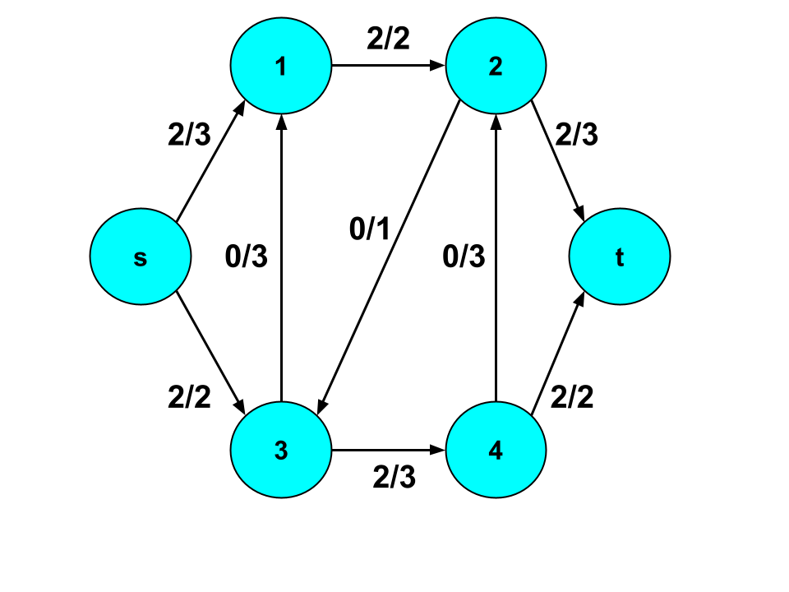
Flow Networks
To start, we shall cover Goldberg’s exact algorithm. But this requires a few concepts to be covered first.
Flow networks are a special type of directed graph where edges have flow (some amount of “something” pushed through the edge). Each edge has a capacity (a maximum flow). This is often represented as x/y, where x is flow and y is capacity.
In a flow network, there are two special nodes called the source and sink. Flow only comes out of the source and only flows into the sink.

Slide 17
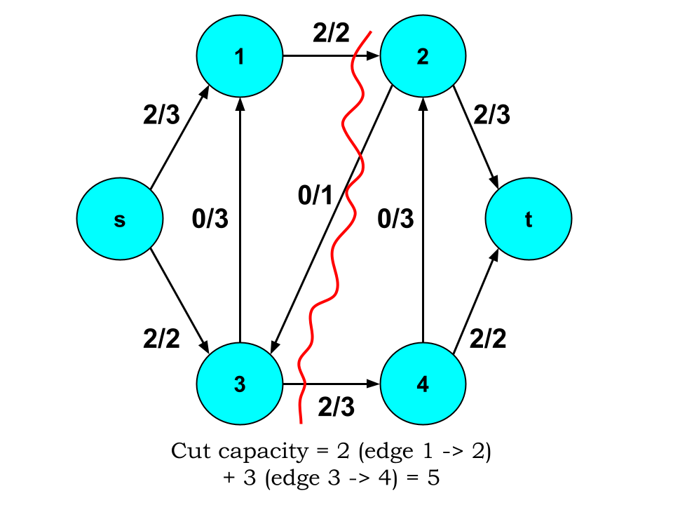
st-cuts
An st-cut is the division of a flow network into two disjointed subgraphs S and T, where S contains the source and T contains the sink.
This cut is made by removing edges until no connection between the subgraphs remains.
The cut capacity of an st-cut is the total sum of the capacities of the cut edges that flowed from S into T.

Slide 18
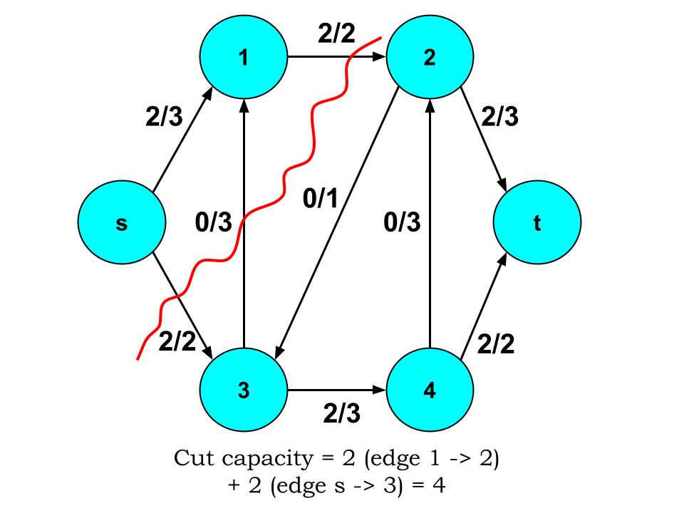
Minimum st-cuts
The minimum st-cut is the st-cut where the cut capacity is minimized.
Importantly, it has been proven that the minimum st-cut value is equal to the maximum flow through the flow network. This means finding one value helps find the other.
In Goldberg’s algorithm, finding the minimum st-cut is an important step, and a Breadth First Search that pushes as much flow down every path possible is used to find the maximum flow. And by taking the st-cut of this max flow graph, the minimum st-cut is found.

Slide 19
Goldberg’s Maximum Flow-Based Algorithm
text

Slide 20
Text
text

Slide 21
Text
text

Slide 22
Text
text

